Slide 1

Predicting filed H1-B Visa Petitions’ Status
Department of Computer Science Engineering
Geethanjali College of Engineering and Technology

Slide 2
Abstract
The H1-B visa in United States allows employers to employ foreign workers in specialty occupations.
The report addresses the approach to predict the case status of the filed H1-B Visa petitions using various input data such as employer name, job category, job title, location of job, filing year, and prevailing wage.
The trained models help to relate the decision with the attributes of the application.
Keywords— H1B, status, classification, evaluation, analysis

Slide 3
Team Members
S Pavan Sushanth (19R11A05D6)
Sarala Vineeth (19R11A05D5)
Samyuktha Alfred (19R11A05D4)
Prajna S (19R11A05D2)
Junaid aHEMED (19R11A05D1)

Slide 4
INTRODUCTION
The US H1-B visa is a non-immigrant visa that allows US companies to employ graduate level workers in specialty occupations that require theoretical or technical expertise in specialized fields such as IT, finance, accounting, architecture, engineering, mathematics, science, medicine, etc.
This is one of the highly used visa categories, and companies that usually require foreign talent rely on it to a great extent.
This report shows an efficient approach to solve the problem of foreseeing the decision before filing or after filing, and before receiving the decision on the filed petition.

Slide 5
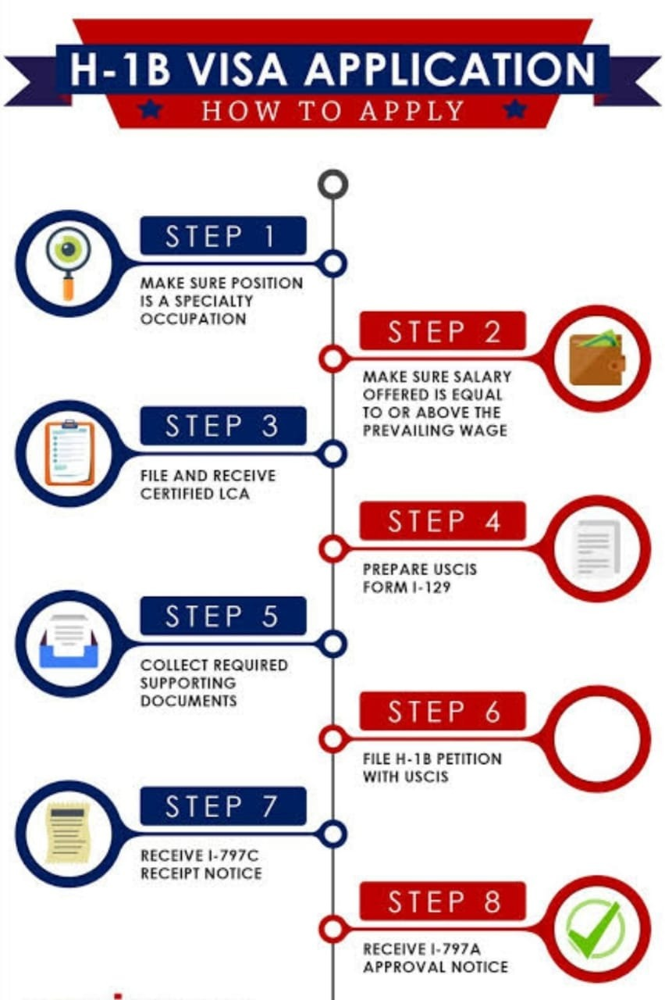
H1B VISA ELIGIBILITY CRITERIA
To obtain the H1-B Visa, you must:
Have 12 years of work experience. It can also be a mix of further education and work experience.
Applicant must hold a bachelor's degree or its equivalent.
United States Citizenship and Immigration Services will determine if your employment constitutes a specialty occupation and if you are qualified to perform the services.
Employer should file a labor condition with the Department of Labor that concerns the terms and conditions of its contract of employment with you.
You must demonstrate that you have the ability to working specialty occupation.
You are willing to come to U.S. to earn and are not coming with the intention to pursue a hobby or to give free adviceor any humanitarian service.

Slide 6
STEPS AFTER APPROVAL OF H1B VISA
Receipt of Approval
After petitioning for an H1B visa, if the petition is selected in the lottery, the petition receipt number and receipt notice from the USCIS will be forwarded by the employer to the applicant. The applicant will use the petition receipt number
Stamping Of H1B Visa
Once the applicant has received the H1B approval notice from his/her employer or attorney, he/she may schedule a visa interview with the US embassy for stamping of the visa on his/her passport. The documents and formalities an applicant will need to furnish and complete for stamping of the visa have been listed below:
Documents And Formalities Required Before The Interview, Duly filled DS-160 Visa Application Form, Schedule H1B, Visa Interview Biometric information, Payment of Visa interview fee

Slide 7
H1B VISA STAMPING DOCUMENTS
Offer Letter from current employer
Copy of resume
Company project documents to describe the nature ofbusiness of the company
Previous H1B approval notice (If applicable)
1-797 A,B, or C
Official Transcripts (Undergraduate, graduate and otherqualifications) Diplomas or degree certificates
Original 1-20 forms (Degrees from the US)Optional Practical Training (OPT) Employment Authorization Document (EAD) cards (If applicable)

Slide 8
BENEFITS OF H1B VISA
The benefits of the H1-B Visa are as follows :
There is no limit to the number of H1-B Visas that an individual can have in his or her lifetime.
H1-B holders can seek Green Card or Lawful Permanent Residency for themselves and their family.
If the employer is terminating a H1B holder before the end of the authorized employment period, the employer must pay a reasonable cost of transportation for the H1-Bholder to go back to his or her home country.
If the H1-B holder is changing jobs, he or she must reapply for a new visa. It however doesn't mean you get another 6 years permit. But those who are converting the H4 visa to H1-B status will get 6 years permit from the date the status changed to H1B status.

Slide 9
PROBLEM FORMULATION
The report tries to show the dependency of the decision on the attributes of the application.
The attributes of the application here serve as an input and the output is the predicted decision.
Name of the employer: Name of employer submitting labor condition application.
Category of the job or SOC Name: Standard Occupational Classification system defines the codes and the names associated with them.
Job title: The requested job title in the petition.
Employment Type: Full time employment (Y) or a part-time employment (N).
Year of Filing: Year when petition is filed (in between 2011-2016).
Prevailing wage: Prevailing Wage for the job being requested for temporary labor condition.

Slide 10
DISTRIBUTION OF STATUS LABELS
CERTIFIED | 2615623
CERTIFIED-WITHDRAWN | 202659
DENIED | 94346
WITHDRAWN | 89799
PENDING QUALITY AND COMPLIANCE REVIEW - UNASSIGNED | 15
REJECTED | 2
INVALIDATED | 1

Slide 11
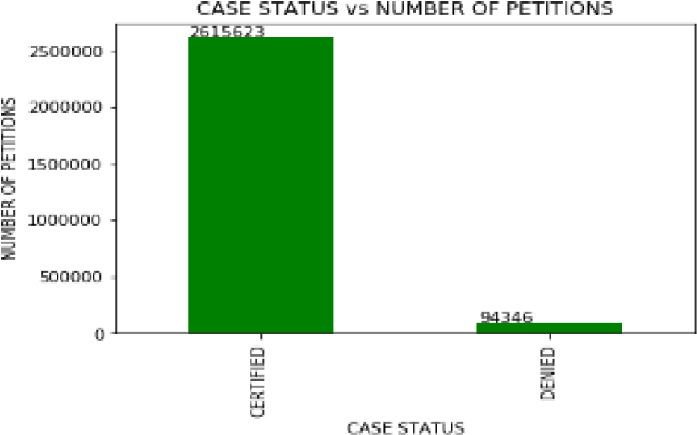
SYSTEM DESIGNProcessing
1.Data Cleaning and Filtering: The raw data considered for the problem statement needs some pre-processing and cleaning depending on its attributes' value. Firstly, all the records with NULL value in either of the attributes were pruned as they can't be handled with any random values. The problem discusses about the decision prediction as either "CERTIFIED" or "DENIED", so all the records containing value as "CERTIFIED" or "DENIED" in their case status were considered for further steps.
Case Status v/s number of petitions

Slide 12
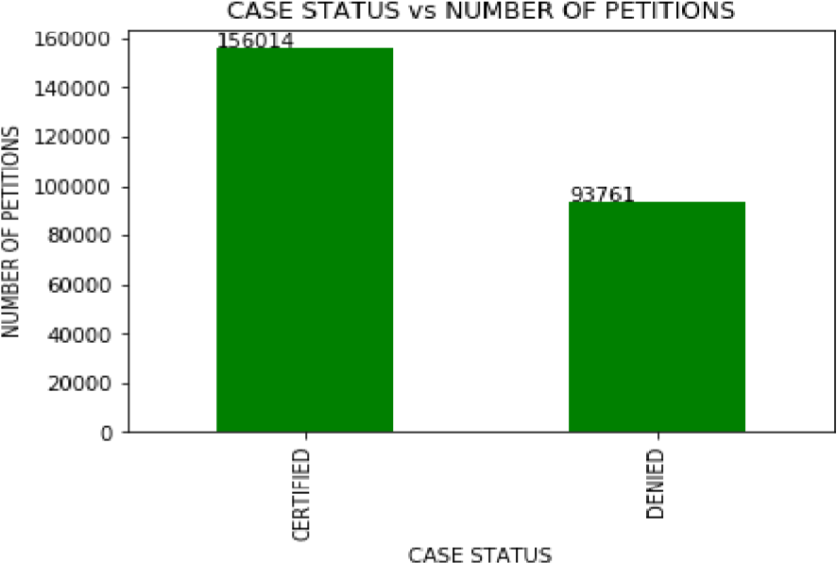
DATA DOWN SAMPLING
The data is highly imbalanced as the samples with certified status are far more than with the ones with denied status. Hence, data balancing becomes the most important step.
We down sampled the certified samples to the count of denied samples, to match with the sample numbers.
The distribution turns out to be as below:

Slide 13
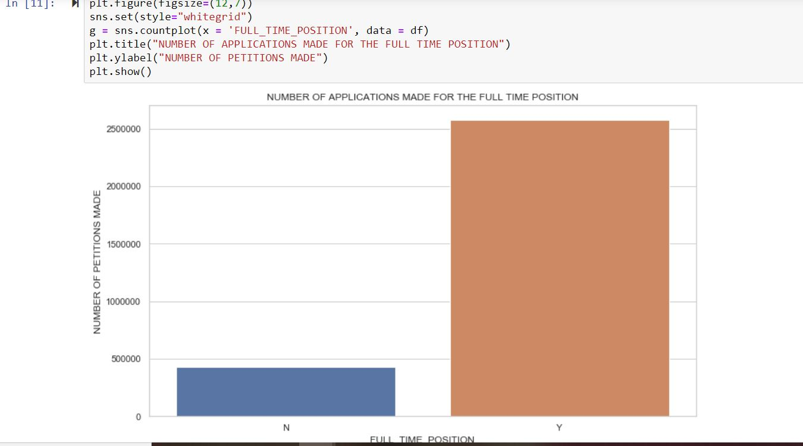

Slide 14
DATA CONSISTENCY THROUGH REFERENCING:
Considering the down sampled data, in SOC names, the data has values like “Computer Systems Analysts” and “Computer Systems Analysts” and many more, which are actually one and the same.
Hence, we took the reference of the job categories as an external file input and the job categories in data were mapped and refined using the ratio threshold of string match as 0.94.
The threshold was derived after calculating the mean of the string match ratio of various random almost similar strings.

Slide 15
DATA CONVERSION AND FEATURES EXTRACTION
We decided to use the one-hot encoding approach to convert the categorical values to numerical.
Since there are chances that after applying hash function on the values of the attributes, they might be converted into the same values.
Data Analysis: Looking at the unique values of the attributes in the below table, it is difficult to convert them to numerical values using one-hot encoding. Hence, we decided to partition the values into categories according to their values.
Case Status: As it has only 2 unique values, it will be easy to apply one-hot encoding

Slide 16
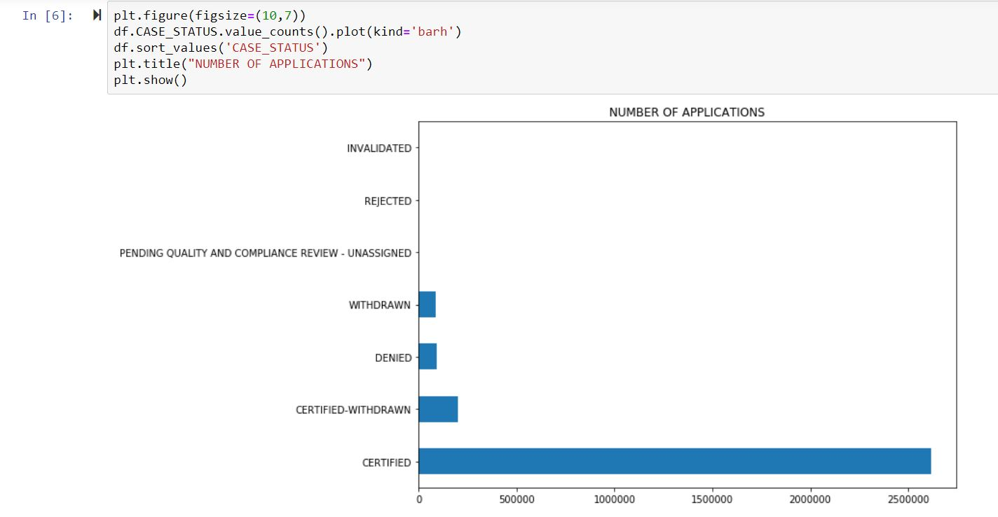

Slide 17
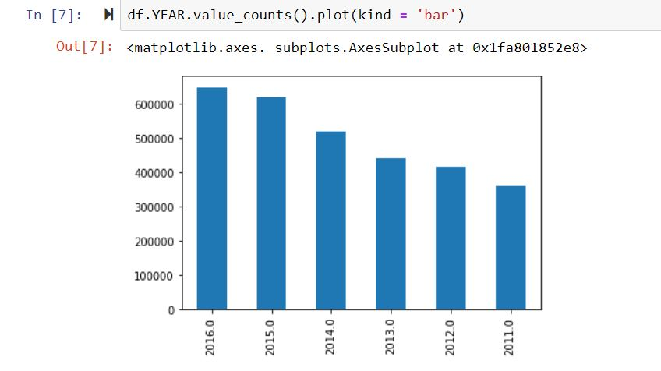
Filing year: Data collection is for the petitions filed between 2011-2016(inclusive), hence 6 unique values.
One-Hot Encoding: Case status, employer acceptance category, SOC acceptance category, job title acceptance category, filing year, wage category, employment type, worksite are passed as the column names in the one-hot encoding function and after application, in total 73 columns are created.

Slide 18
FEATURE SELECTION:
Relative effect of the attributes' values on the final decision making, a feature elimination model called Recursive Feature Elimination(RFE) was employed. In RFE, weights are assigned to the features and then least important features are eliminated recursively from the current set of features until the desired number of features are eventually reached.
Considering the output of RFE, attributes employer acceptance level, job acceptance level, wage category, worksite state and filing year. Top attributes selected are: {'EMPLOYER', 'FILING', 'FULL', 'JOB', 'SOC', 'WAGE', 'WORKSITE'}
Hence, employer acceptance category, filing year, job title acceptance category, wage category, work state, job type, soc acceptance category is considered further.

Slide 19
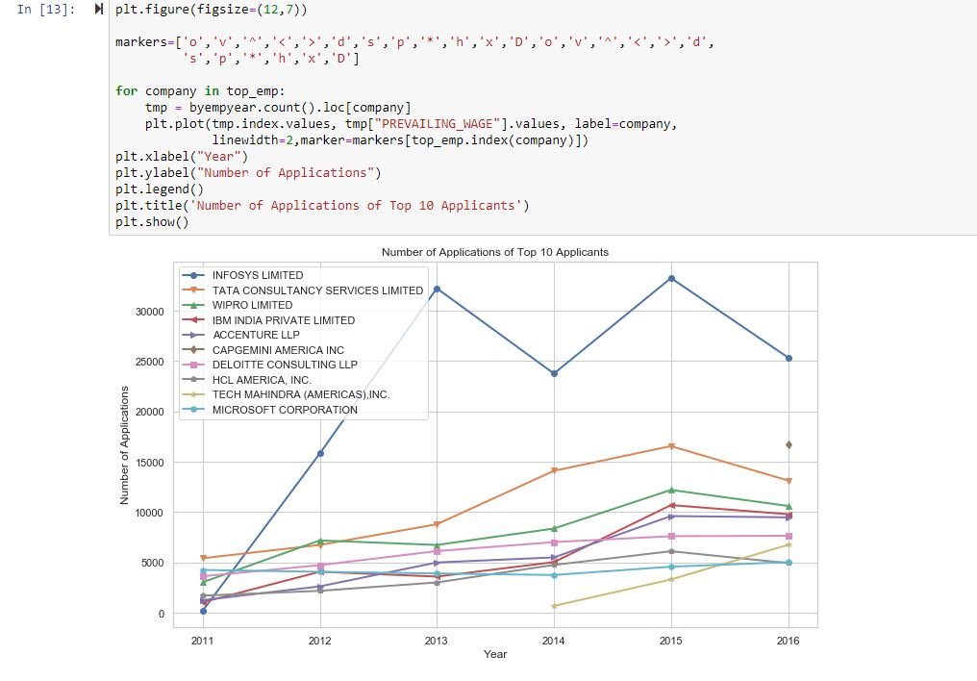

Slide 20
EXPERIMENTAL EVALUATION :
Data Splitting :In classification, we divide the data into two sets viz. 1. Training Data 2. Test Data. We considered 20 percent of the total records for test data and the rest of 80 percent for training the classifiers.
Models Applied : We trained total 3 different classifiers for predication task and evaluated each based on the evaluation metrics.
k-Nearest Neighbour(k-NN)
Logistic Regression
Random Forest

Slide 21
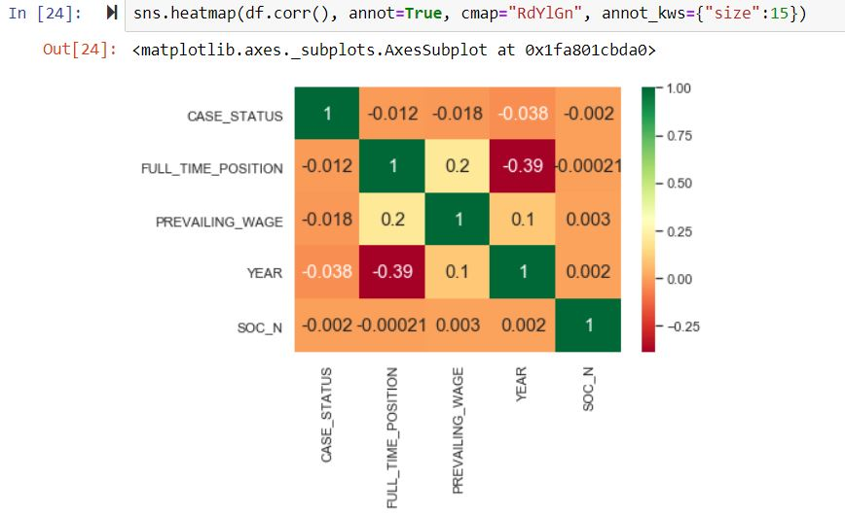

Slide 22
MODEL EVALUATION METRICS
All the classifier models were evaluated using three types of metrices.
Precision Score: Precision Score is calculated as the ratio of correctly predicted positive observations to the total predicted positive observations.
Precision = TP/ TP + FP
Recall Score: Recall is calculated as the ratio of correctly predicted positive observations to the all observations in actual class – yes.
Recall = TP/TP+FN
F1 Score: F1-Score is calculated as a weighted average of both precision and recall score.
F1 Score=2*(Recall*Precision)/ (Recall +
Precision)
Here,
FP = False Positive: Predicted Yes when Actual is No
FN = False Negative: Predicted No when Actual is Yes
TP = True Positive: Predicted Yes when Actual Yes
TN = True Negative: Predicted No when Actual No

Slide 23
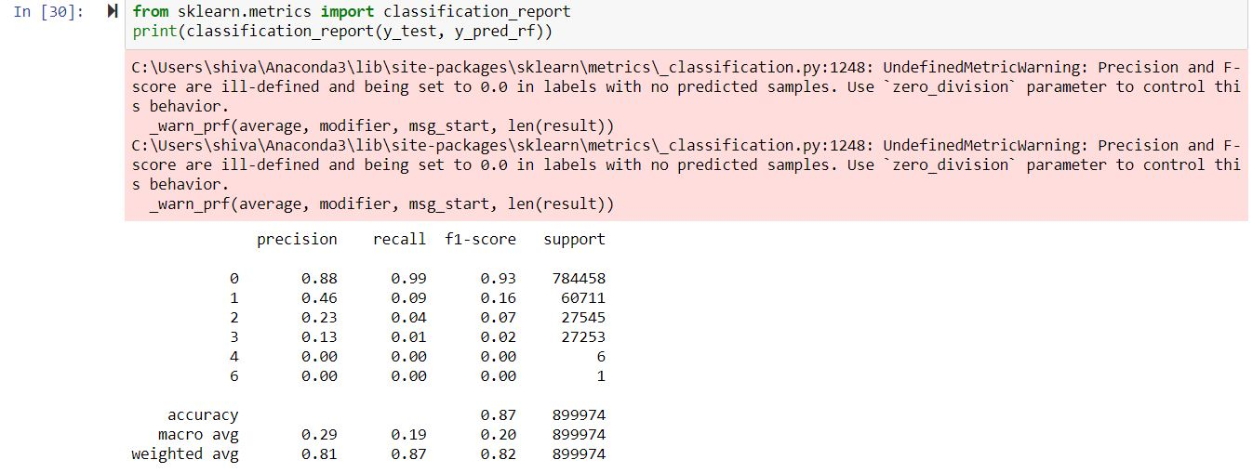

Slide 24
MODEL EVALUATION RESULTS
Compared to all approaches presented till date, we have achieved the highest accuracy of prediction task through application of Artificial Neural Network and Logistic Regression along with Random Forest.
Hence we chose to predict with Random forest.
Data balancing played a major role in achieving the high accuracy for both the classes. We also infer that job title, employer name/employer acceptance ratio, wages, worksite and filing year play an important role in inferring the value of the case status.

Slide 25
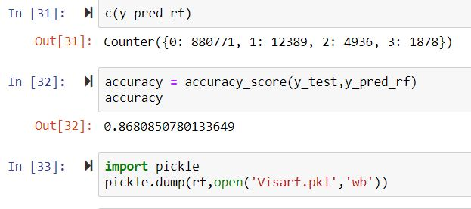
Final Prediction with accuracy:

Slide 26
LEARNING EXPERIENCES
As a team, we learnt that
Data balancing is an important step when the data is imbalanced else the results will be inclined towards the class with larger number of records
Categorizing feature values helps to draw meaning out of the categorical variables
Artificial Neural Network’s performance reduces if the number of hidden layers are comparatively high and the data is not complex. Because, it converges easily and then the rest of layers adds unnecessary overhead.
Thus concluding….as this has taught us that data managing makes it easier for us to predict and analyze any future decisions.

Slide 27
Thank You
Team -04

